Slide 1
Basic Definitions
Binary Operators
  AND
    z = x • y = x y z=1 if x=1 AND y=1
  OR
    z = x + y z=1 if x=1 OR y=1
  NOT
    z = x = x’ z=1 if x=0
Boolean Algebra
  Binary Variables: only ‘0’ and ‘1’ values
  Algebraic Manipulation

Slide 2
Boolean Algebra Postulates
Commutative Law
  x • y = y • x x + y = y + x
Identity Element
  x • 1 = x x + 0 = x
Complement
  x • x’ = 0 x + x’ = 1

Slide 3
Boolean Algebra Theorems
Duality
  The dual of a Boolean algebraic expression is obtained by interchanging the AND and the OR operators and replacing the 1’s by 0’s and the 0’s by 1’s.
  x • ( y + z ) = ( x • y ) + ( x • z )
  x + ( y • z ) = ( x + y ) • ( x + z )
Theorem 1
  x • x = x x + x = x
Theorem 2
  x • 0 = 0 x + 1 = 1
Applied to a valid equation produces a valid equation

Slide 4
Boolean Algebra Theorems
Theorem 3: Involution
  ( x’ )’ = x ( x ) = x
Theorem 4: Associative & Distributive
  ( x • y ) • z = x • ( y • z ) ( x + y ) + z = x + ( y + z )
  x • ( y + z ) = ( x • y ) + ( x • z )
  x + ( y • z ) = ( x + y ) • ( x + z )
Theorem 5: DeMorgan
  ( x • y )’ = x’ + y’ ( x + y )’ = x’ • y’
  ( x • y ) = x + y ( x + y ) = x • y
Theorem 6: Absorption
  x • ( x + y ) = x x + ( x • y ) = x

Slide 5
Theorem 1 x + x = x , x.x = x Proof
x+ x = ( x + x ).1
= (x+x) (x+x’)
= x + xx’
= x + 0
=x
x.x =x
x.x = xx +0
= xx + xx’
= x(x+x’)
= x.1
= x

Slide 6
Theorem 2 X+1 =1 proof
x+1 = 1. (x+1)
= (x+x’) (x +1)
= x + x’.1
= x+x’
= 1

Slide 7
Theorem 6: Absorption x + xy = x
Proof : x + xy = x.1 + xy
= x(1+y)
= x. 1
= x

Slide 8
Truth Table to Verify DeMorgan’s
X + Y = X · Y
X · Y = X + Y
X | Y | X·Y | X+Y | X | Y | X+Y | X · Y | X·Y | X+Y
0 | 0 | 0 | 0 | 1 | 1 | 1 | 1 | 1 | 1
0 | 1 | 0 | 1 | 1 | 0 | 0 | 0 | 1 | 1
1 | 0 | 0 | 1 | 0 | 1 | 0 | 0 | 1 | 1
1 | 1 | 1 | 1 | 0 | 0 | 0 | 0 | 0 | 0
Generalized DeMorgan’s Theorem:
X₁ + X₂ + … + X_{n} = X₁ · X₂ · … · X_{n}
X₁ · X₂ · … · X_{n} = X₁ + X₂ + … + X_{n}
Notes:
We can also use algebraic properties in doing this proof.
We will show that, x’ . y’, satisfies
the definition of the complement of (x + y), defined as (x + y)’ by
DeMorgan’s Law.
To show this we need to show that A + A’ = 1 and A.A’ = 0 with
A = x + y and A’ = x’. y’. This proves that x’. y’ = (x + y)’.
Part 1: Show x + y + x’. y’ = 1.
x + y + x’. y’
= (x + y + x’) (x + y + y’) X + YZ = (X + Y)(X + Z) (Distributive Law)
= (x + x’ + y) (x + y + y’) X + Y = Y + X (Commutative Law)
= (1 + y)(x + 1) X + X’ = 1
= 1 . 1 1 + X = 1
= 1 1 . X = 1
Part 2: Show (x + y) . x’. y’ = 0.
(x + y) . x’. y’
= (x . x’. y’ + y . x’. y’) X (Y + Z) = XY + XZ (Distributive Law)
= (x . x’. y’ + y . y’ . x’) XY = YX (Commutative Law)
= (0 . y’ + 0 . x’) X . X’ = 0
= (0 + 0) 0 . X = 0
= 0 X + 0 = X (With X = 0)
Based on the above two parts, x’y’ = (x + y)’
The second DeMorgans’ law is proved by duality. Note that DeMorgan’s
Law, given as an identity is not an axiom in the sense that it can be
proved using the other identities.

Slide 9
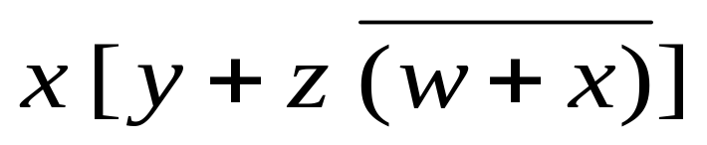
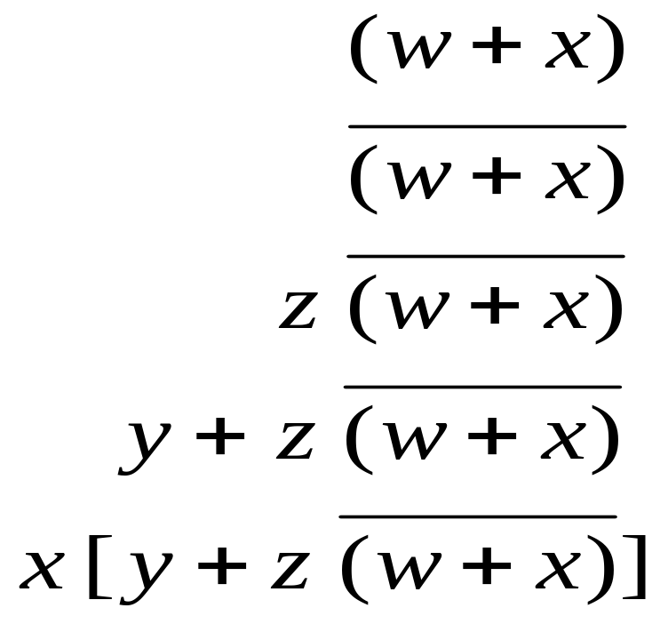
Operator Precedence
Parentheses
  ( . . . ) • ( . . .)
NOT
  x’ + y
AND
  x + x • y
OR

Slide 10
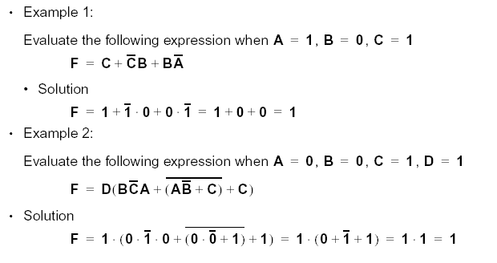
Function Evaluation

Slide 11
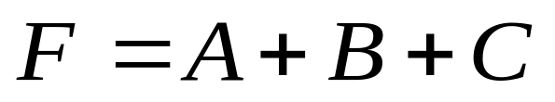
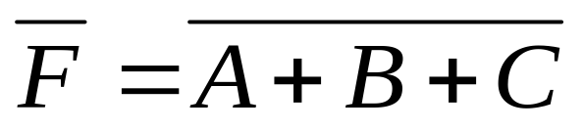
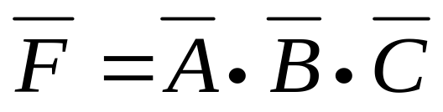
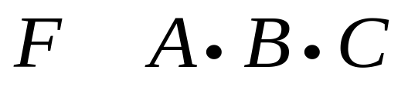
Complement of a Function
DeMorgan’s Theorm
Duality & Literal Complement

Slide 12
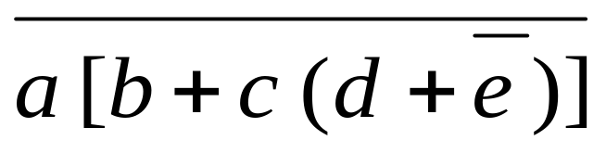
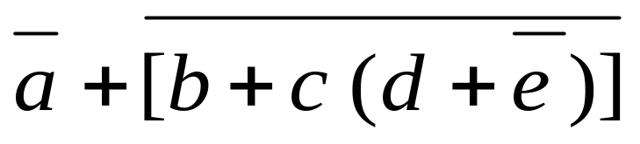
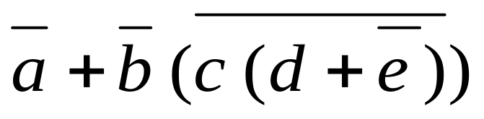
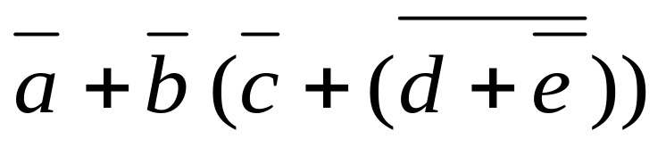
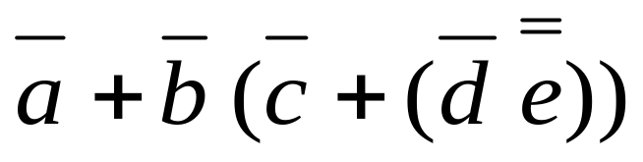
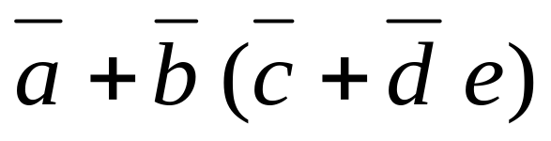
Simplify using DeMorgan’s Theorem

Slide 13
Algebraic Manipulation
Literal:
  A single variable within a term that may be complemented or not.
Use Boolean Algebra to simplify Boolean functions to produce simpler circuits
  Example: Simplify to a minimum number of literals
  F = x + x’ y ( 3 Literals)
  = x + ( x’ y )
  = ( x + x’ ) ( x + y )
  = ( 1 ) ( x + y ) = x + y ( 2 Literals)
Distributive law (+ over •)

Slide 14
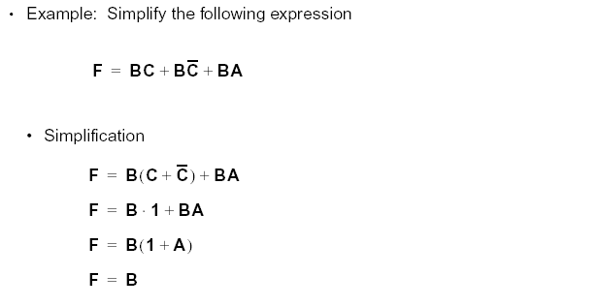
Function Manipulation (1)

Slide 15
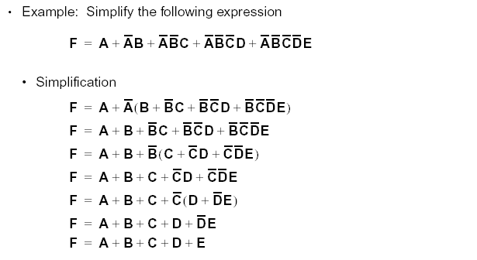
Function Manipulation (2)

Slide 16
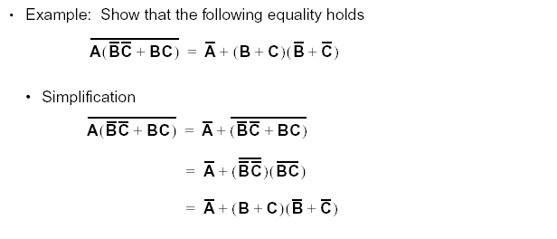
Function Manipulation (3)

Slide 17
Simplify the Boolean equation and describe the logic circuit:
Y= A’B’C’ + A’BC’ + AB’C’ + ABC’
Y= A’B’C’ + A’BC’ + AB’C’ + ABC’
Y = C’(A’B’ +A’B+AB’+AB)
Y = C’[A’ (B’+B) + A (B’+B)]
Y = C’[A’ (1) + A (1)]
Y=C’(A’+ A)
Y = C’(1)= C’

Slide 18
Convert Truth Table to Expression-Example
C (Input) | B (Input) | A (Input) | Y (Output)
0 | 0 | 0 | 0
0 | 0 | 1 | 0
0 | 1 | 0 | 0
0 | 1 | 1 | 1
1 | 0 | 0 | 1
1 | 0 | 1 | 0
1 | 1 | 0 | 0
1 | 1 | 1 | 0
C’BA+CB’A’=Y

Slide 19
Boolean Expression to Truth Table
1. C’BA’+CB’A=Y
2. C’A’+CBA=Y
A | B | C | Y
0 | 0 | 0 | 1
0 | 0 | 1 | 0
0 | 1 | 0 | 1
0 | 1 | 1 | 0
1 | 0 | 0 | 0
1 | 0 | 1 | 0
1 | 1 | 0 | 0
1 | 1 | 1 | 1

Slide 20
SOP & POS
Sum of products: It is a Boolean expression where different AND terms are ORed. It is denoted by SOP
e.g. xyz+x’y’z+x’y’z’
xy + x’y’
xyz + y + x
Product of sums: It is a Boolean expression where different OR terms are ANDed. It is denoted by POS
e.g. (y+x’) (x+z) (y+z)
(y+x’+z’) (x+z+y) (x+z+y’)

Slide 21
POS and SOP
(xy + x’y) (x’y’+ xy)
which out of the above 2 forms is it represented in?
Ans: none. It is neither SOP nor POS

Slide 22
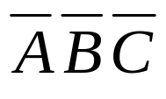
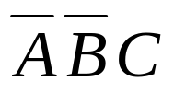
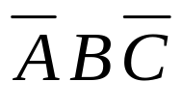
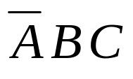
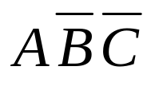
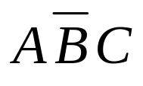
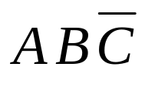

Canonical Forms
Minterm (Standard product)
  Product (AND function)
  Contains all variables
  Evaluates to ‘1’ for a
  specific combination
  Example
  A = 0 A B C
  B = 0 (0) • (0) • (0)
  C = 0
 | A B C | Minterm
0 | 0 0 0 | m₀
1 | 0 0 1 | m₁
2 | 0 1 0 | m₂
3 | 0 1 1 | m₃
4 | 1 0 0 | m₄
5 | 1 0 1 | m₅
6 | 1 1 0 | m₆
7 | 1 1 1 | m₇
1 • 1 • 1 = 1

Slide 23

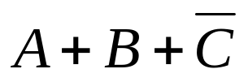
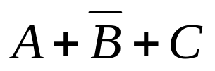
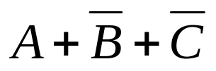
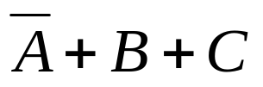
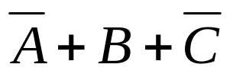
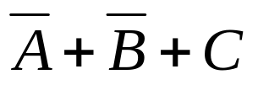
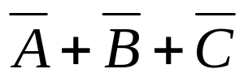
Canonical Forms
Maxterm(Standard Sum)
  Sum (OR function)
  Contains all variables
  Evaluates to ‘0’ for a
  specific combination
  Example
  A = 1 A B C
  B = 1 (1) + (1) + (1)
  C = 1
 | A B C | Maxterm
0 | 0 0 0 | M₀
1 | 0 0 1 | M₁
2 | 0 1 0 | M₂
3 | 0 1 1 | M₃
4 | 1 0 0 | M₄
5 | 1 0 1 | M₅
6 | 1 1 0 | M₆
7 | 1 1 1 | M₇
0 + 0 + 0 = 0

Slide 24
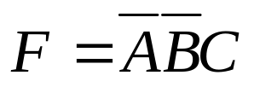
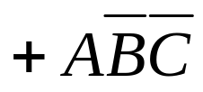
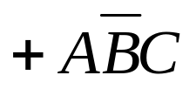

Canonical Forms
Truth Table to Boolean Function
A B C | F
0 0 0 | 0
0 0 1 | 1
0 1 0 | 0
0 1 1 | 0
1 0 0 | 1
1 0 1 | 1
1 1 0 | 0
1 1 1 | 1

Slide 25
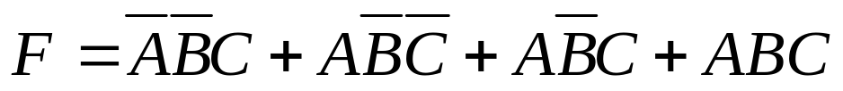
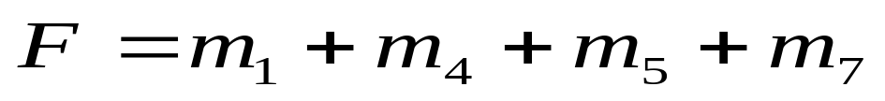
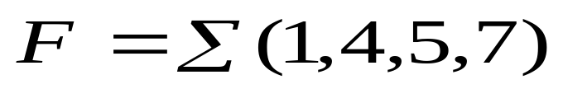
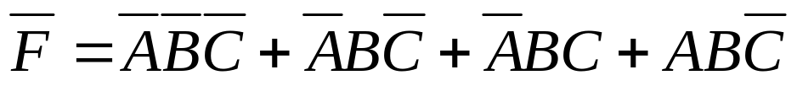
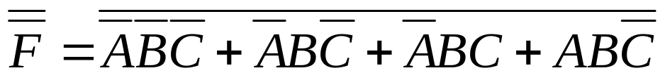
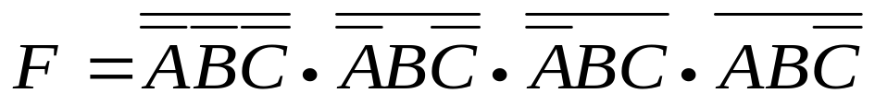
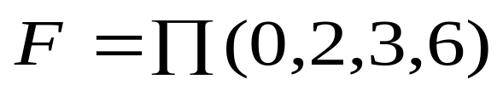
Canonical Forms
Sum of Minterms
Product of Maxterms
 | A B C | F
0 | 0 0 0 | 0
1 | 0 0 1 | 1
2 | 0 1 0 | 0
3 | 0 1 1 | 0
4 | 1 0 0 | 1
5 | 1 0 1 | 1
6 | 1 1 0 | 0
7 | 1 1 1 | 1
F
1
0
1
1
0
0
1
0

Slide 26
Standard form / Canonical Form
Standard form: In a standard form we don’t have to compulsorily write all the literals in all the terms of an expression.
e.g. f = xyz + y + x
f = x’y’z’ + x’yz
f= xy + x’y’
Canonical form: In a canonical form we have to compulsorily write all the literals in all the terms of an expression.
e.g. xyz+x’y’z+x’y’z’

Slide 27
Standard form / Canonical Form
Eg. xy+yz+x’y’ (for 2 variables)
x+y (for 1 variable)
xyz+xyz’
But xy + x & xyz+x’yz+xz are not a canonical term
We can represent the expressions using min terms or max terms but we first convert standard form of expression to canonical form and then we write the expression in terms of min or max terms

Slide 28
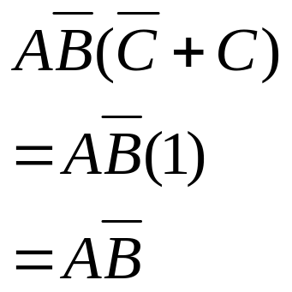
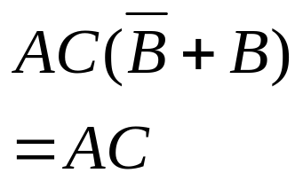
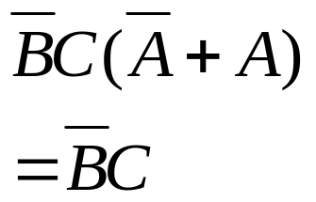
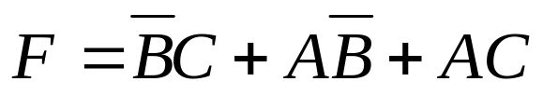
Standard Forms
Sum of Products (SOP)

Slide 29
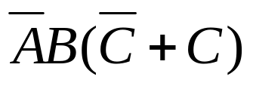
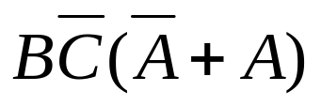
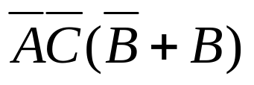
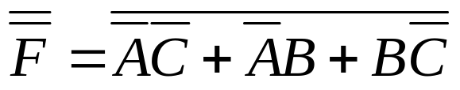
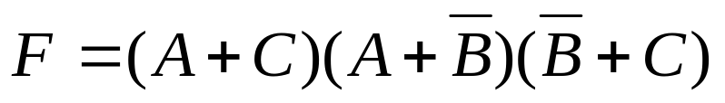
Standard Forms
Product of Sums (POS)

Slide 30
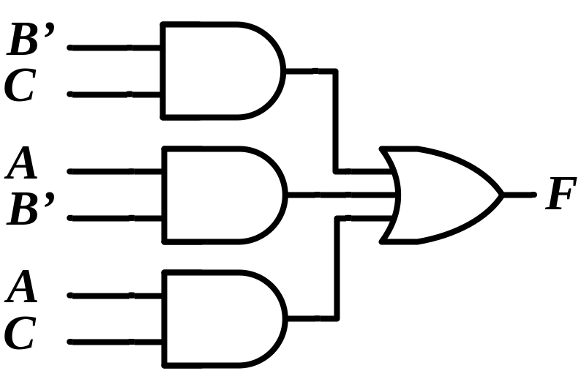

Two - Level Implementations
Sum of Products (SOP)
Product of Sums (POS)

Slide 31

Standard Sum-of-Products (SOP)

Slide 32



AND/OR Two-level Implementation of SOP Expression

Slide 33




Standard Product-of-Sums (POS)

Slide 34



OR/AND Two-level Implementation

Slide 35

SOP and POS Observations

Slide 36





Equivalent Cost Circuits

Slide 37
Boolean Function Simplification
Reducing the literal cost of a Boolean Expression leads to simpler networks.
Simpler networks are less expensive to implement.
Boolean Algebra can help us minimize literal cost.

